Slide 1
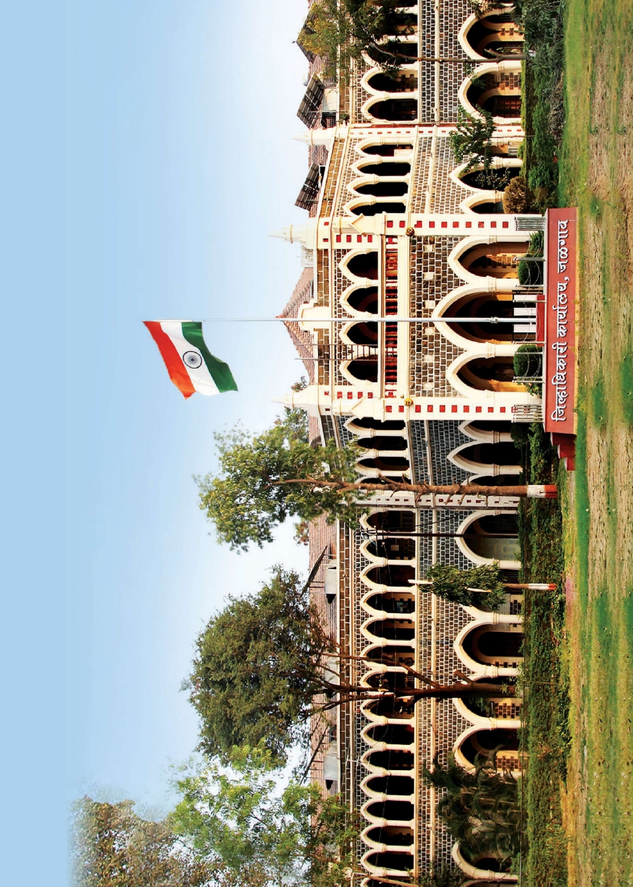


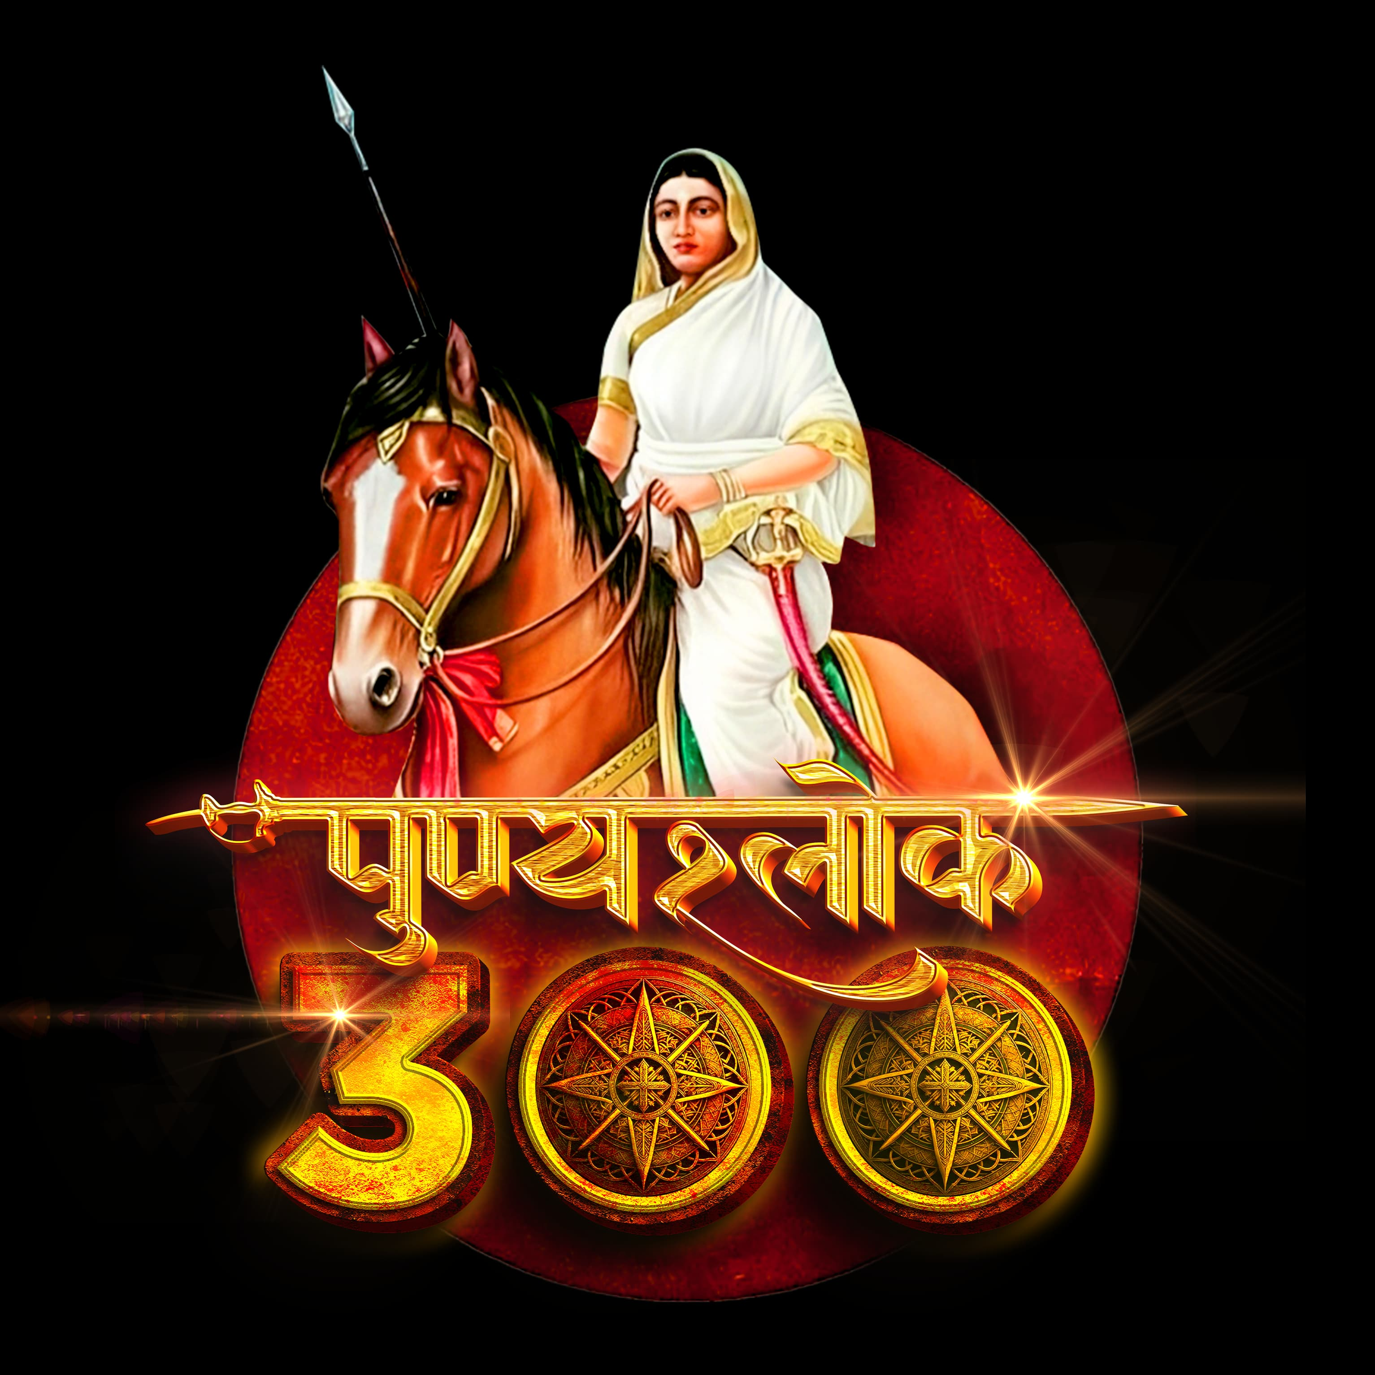
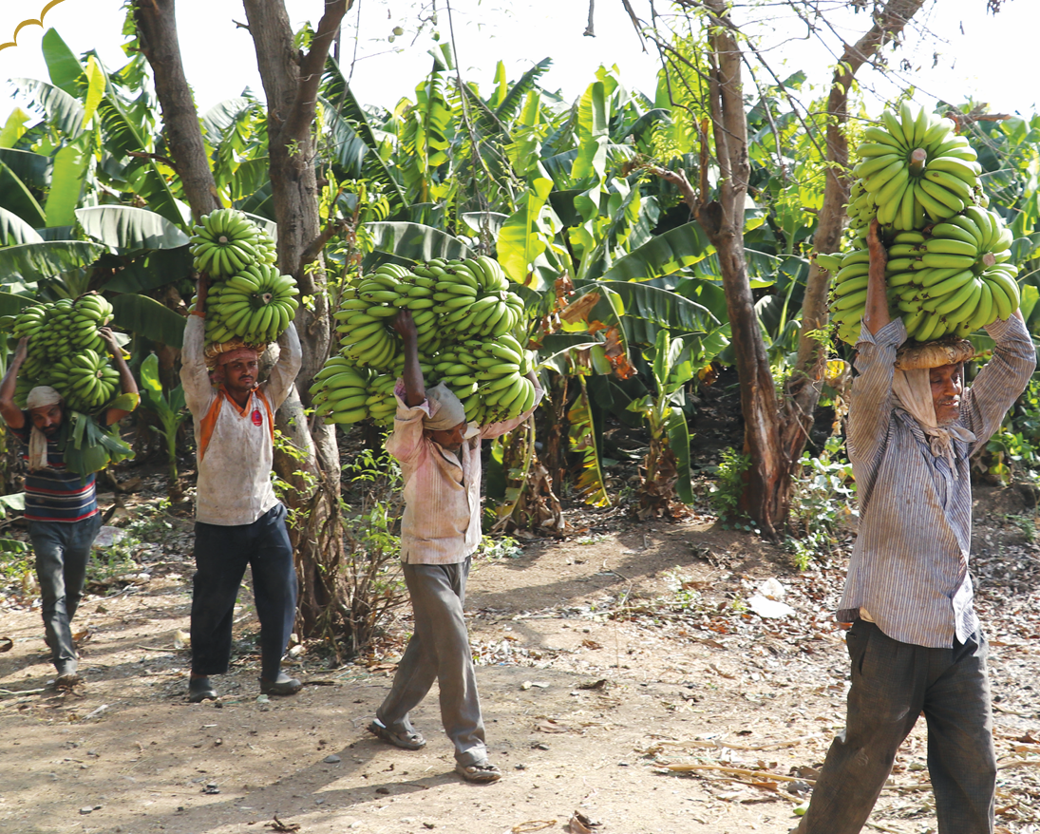
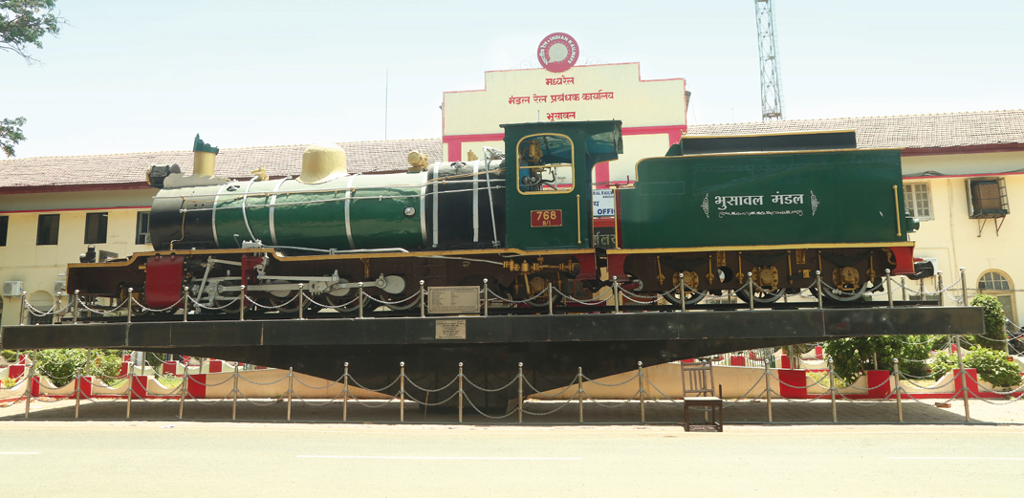
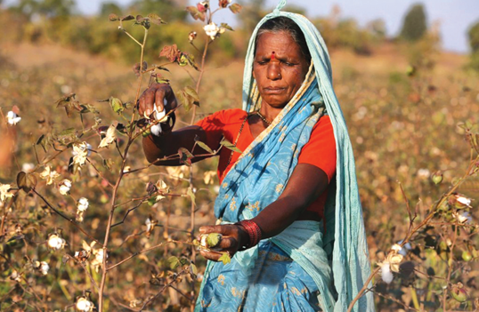
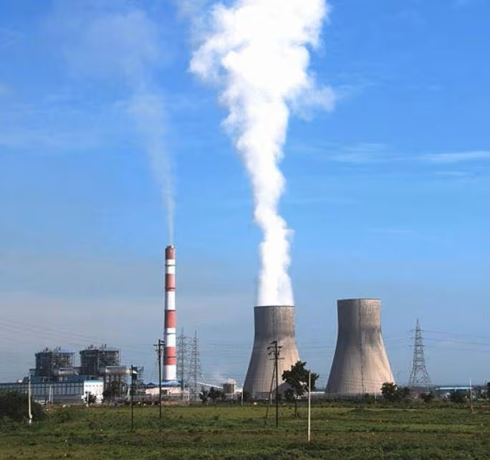
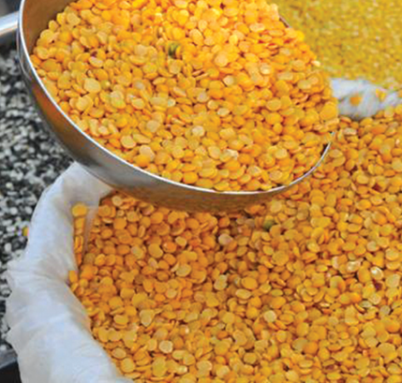

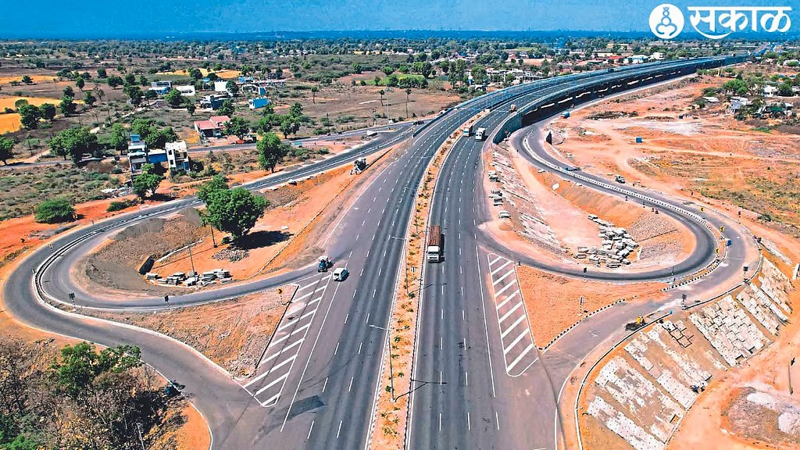
Strategic Transformation of Jalgaon: Innovation, Investment, Impact
Presented By,
Ayush Prasad
District Collector, Jalgaon
2025

Slide 2



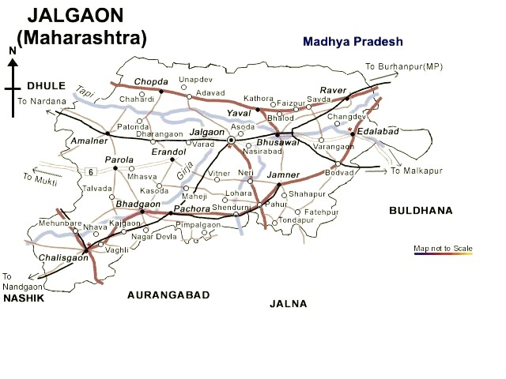
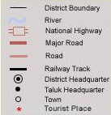

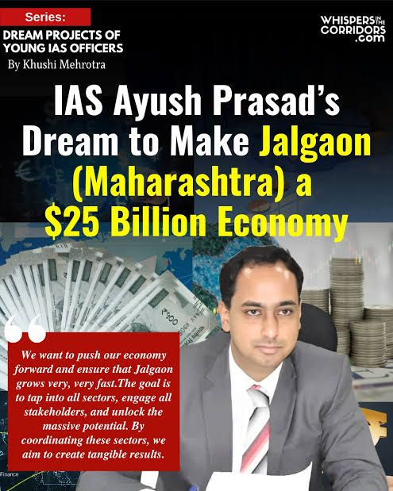
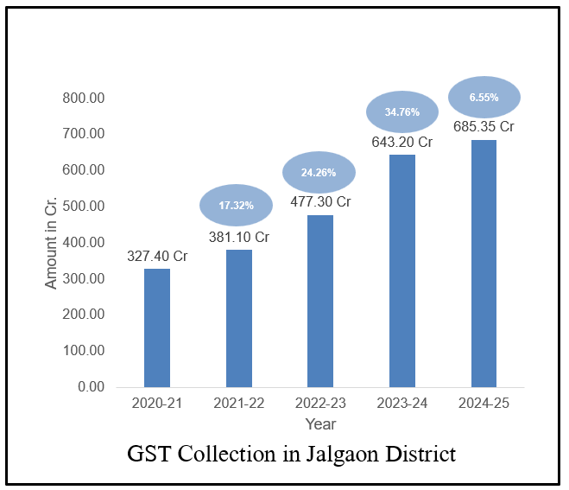
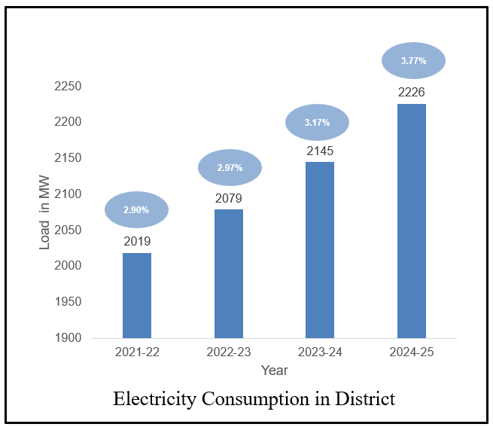
Jalgaon District
Total Projected Population:
47,40,882 (As of 01.01.2024 – Source: Directorate of Economics and Statistics)
Working Age Population 30,55,066
HDI – 0.723
Total Cultivable Area:
7,71,000 hectares
Farmer Classification:
Marginal Farmers (up to 1 ha): 1,94,457 (40.64%)
Small Farmers (1 to 2 ha): 1,72,818 (36.09%)
Area Under Cotton Cultivation: 5,01,568 hectares
MIDC:
No. of MIDC Zone – 3
(Jalgaon, Bhusawal, Chalisgaon)
No. of Projects in MIDC – 2702
Area In MIDC – 574.19 Ha
Investment - 9719.04 Cr.
(Source : District Socio Economic Abstract 2025)
Proposed : Pachora, Jamner, Chopda
6 National Highways 10 Railway Lines
Economy
Maharashtra contributes 13% to India's economy and aims to be 20% of India.
Jalgaon contributed 4% to Maharashtra's economy in 2000, has declined to 1.6% now, but it aims be 2.5% in 2029
GROWTH in %
GROWTH in %

Slide 3





1st Year Action Plan – Strengthen the Existing
Agriculture
Agri-Allied
Industry
Services
Infrastructure
8 major irrigation projects
irrigation potential of 2,65,785 hectares
Power Substations
46 for RP industries
MIDC
7 SME Cluster
5 Urban Growth Centers
Policy
D+ Zone
Defense PSU Land
Lease Policy
Development Plan for Soft Infrastructure
Rs. 100 Cr
Banana Cluster
Cluster
One Taluka One Crop
Crop Diversification
Spices Cluster on Forest Rights Act Land
Circular Economy – Plastic & Metal
Precision Manufacturing (eV Battery & Gold)
Medical Hub
Insurance Consultancy
Value
Chain
Fly Ash
eMarket Fulfillment Center
Tissue Culture Crops
3891 Farm Ponds
Ripening Centers
Pet Food Cluster
Institution
Export Certificates
Bullion Banking,
Letters of Credit
Aviation Training + Air Services Training
PACS to FPO
Inter Cropping

Slide 4
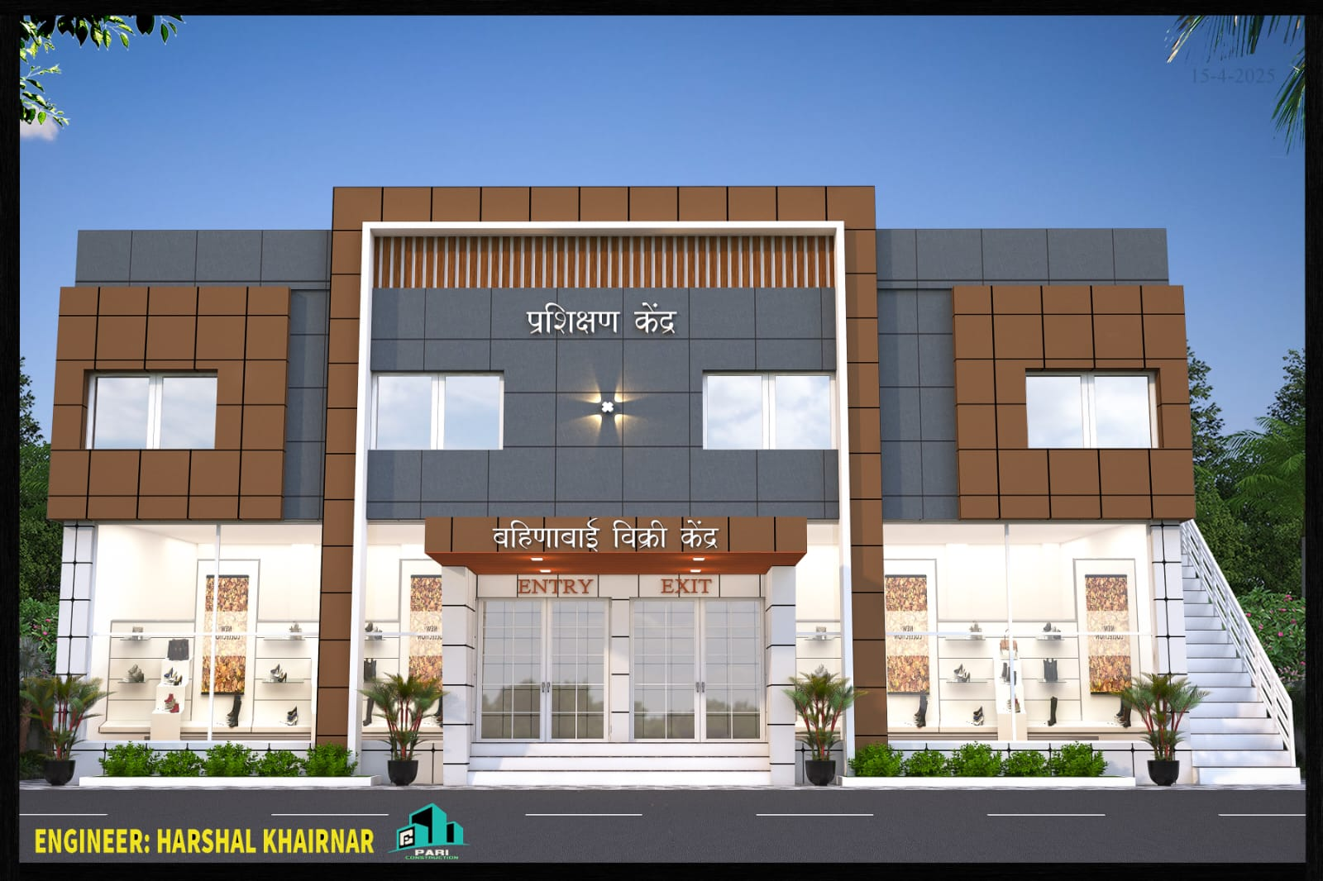
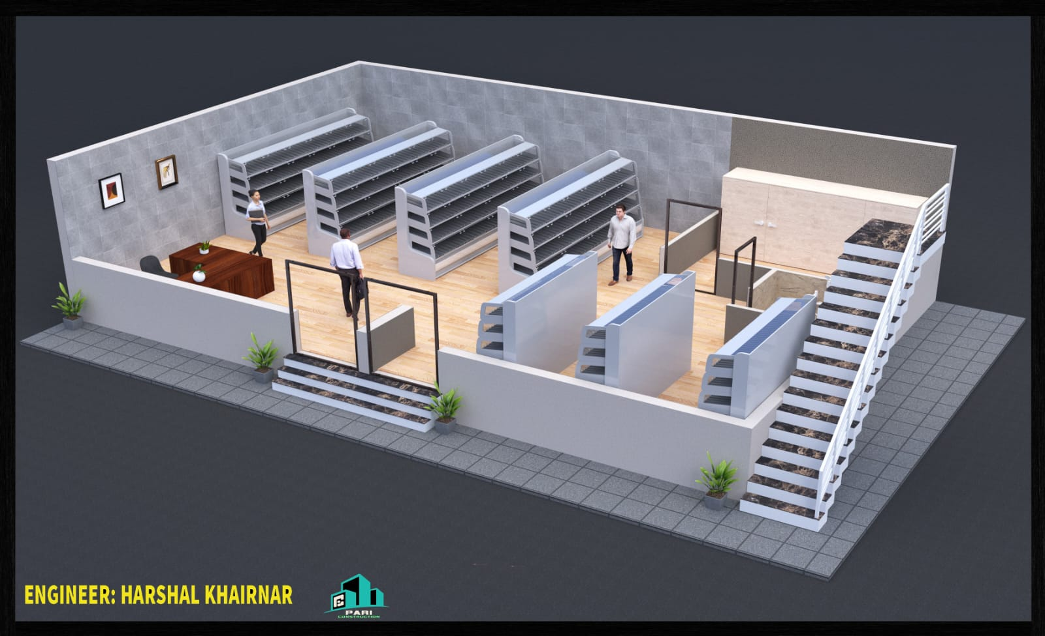
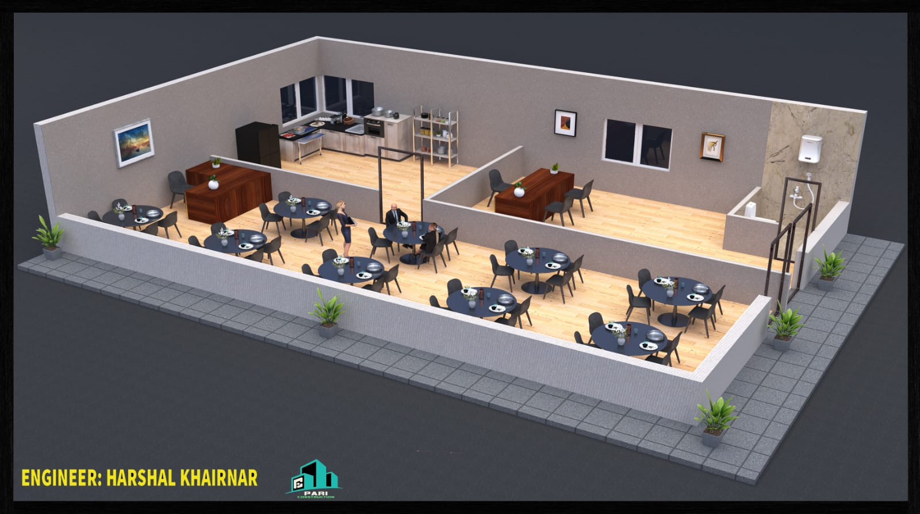
DLI 1 - Improved Performance of District linked to implementation of DSPs
₹151 crore from DPDC
Preparing for Business
Regional Plan Industrial Zone
Laadki Behn Economy
Rs. 1800 Cr. Grant
12 Bahina Marts Under Construction
Green Energy
63,000 Hectares of Gairan Land
Napier Grass Plantation
Roads,
Electricity &
Water

Slide 5
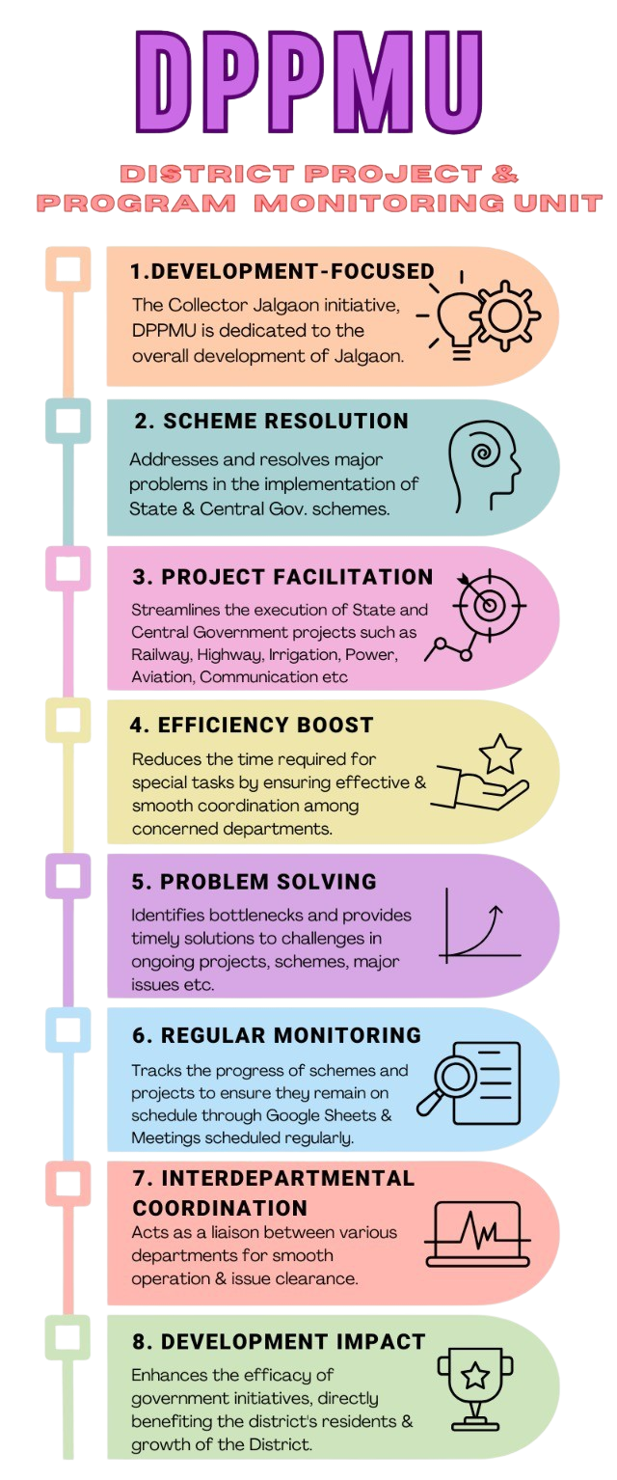
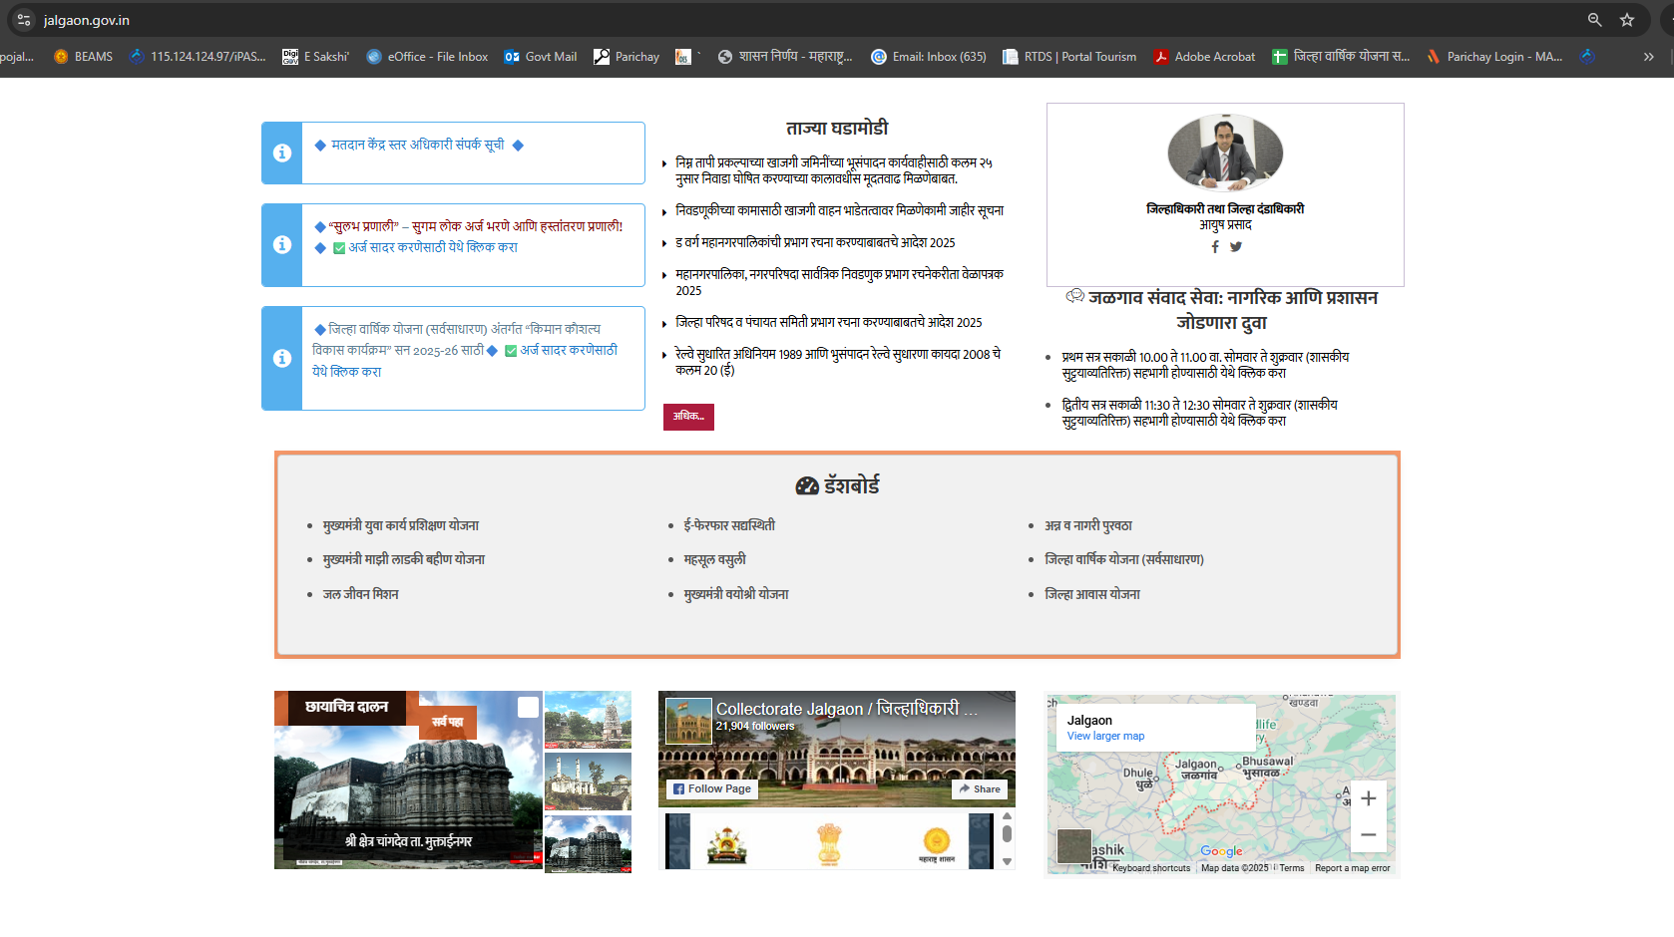
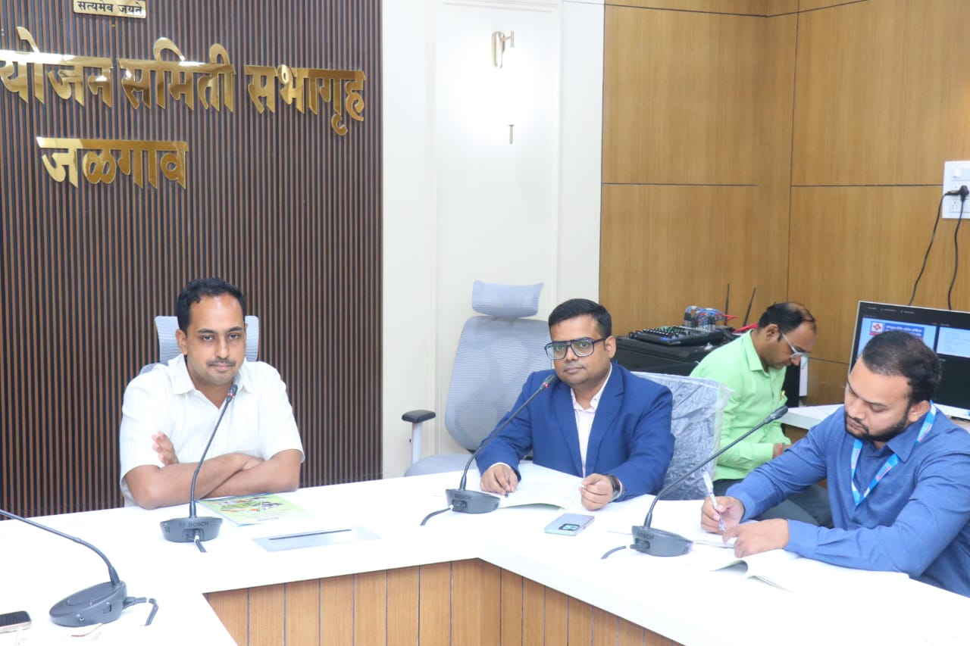
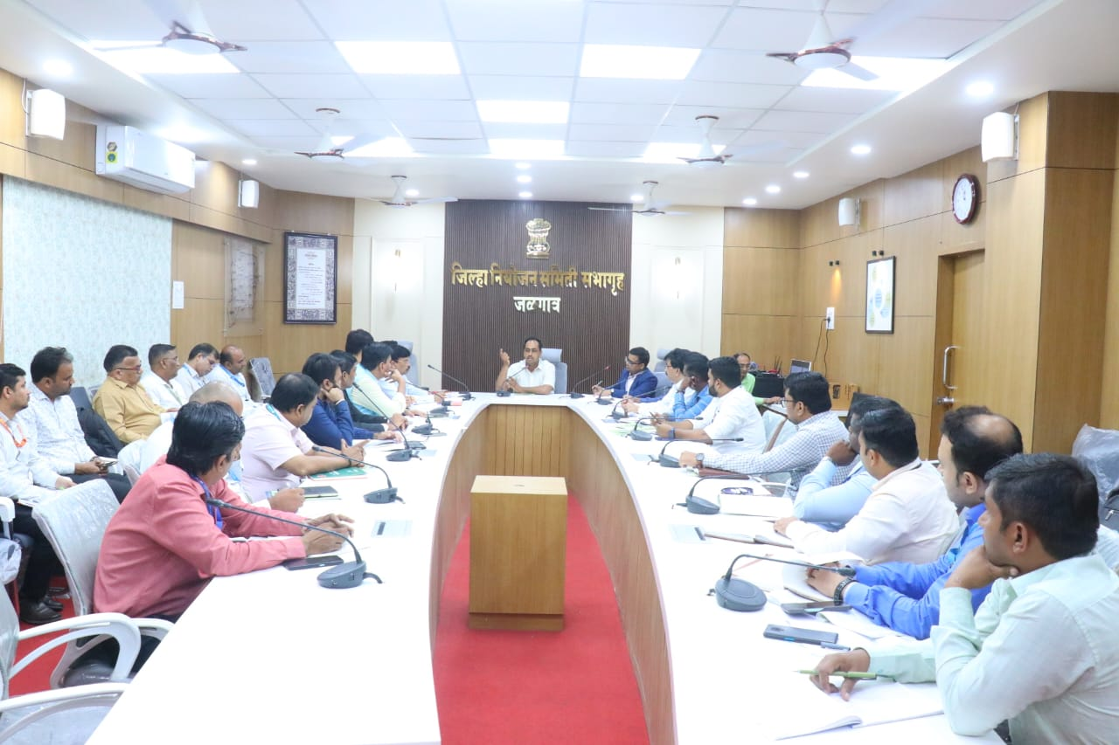
DLI – 2 Improved Avaibility and Use of Data for DSP’s
DPPMU monitoring total 62 Government + 7 Private Projects
131 district-level mechanisms are regularly reviewed.
Out of 10,856 key issues identified
7,569 issues resolved
District Dashboard website
GIS Layering enable investment promotion

Slide 6
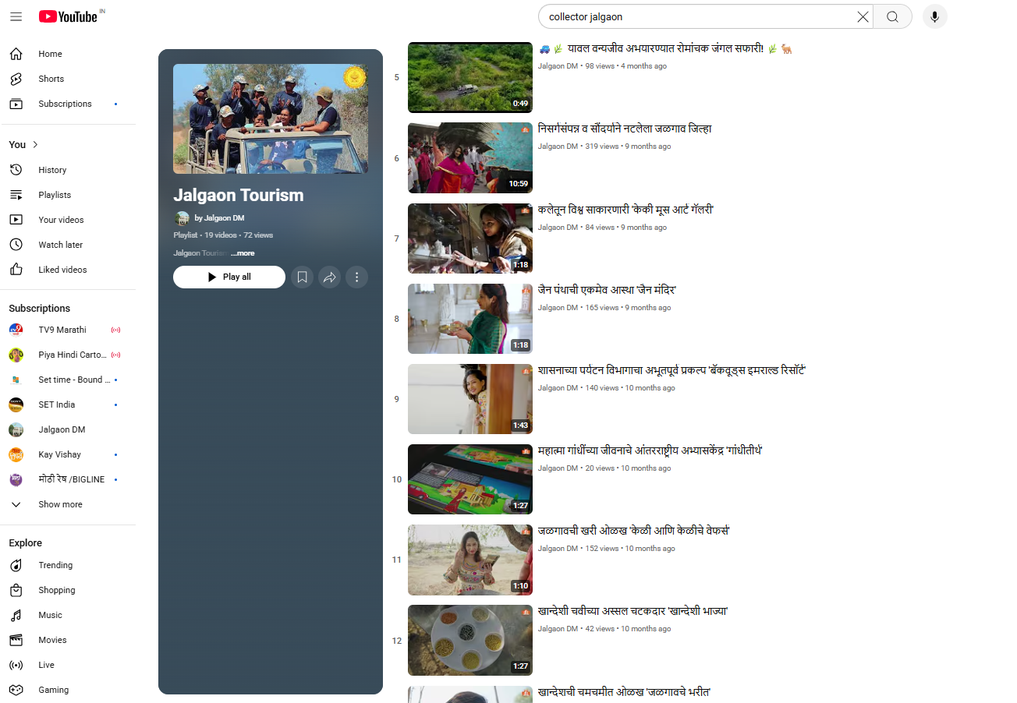
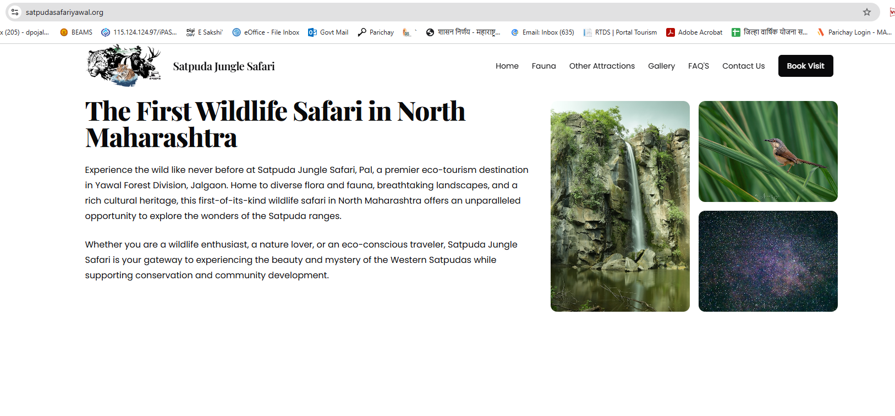
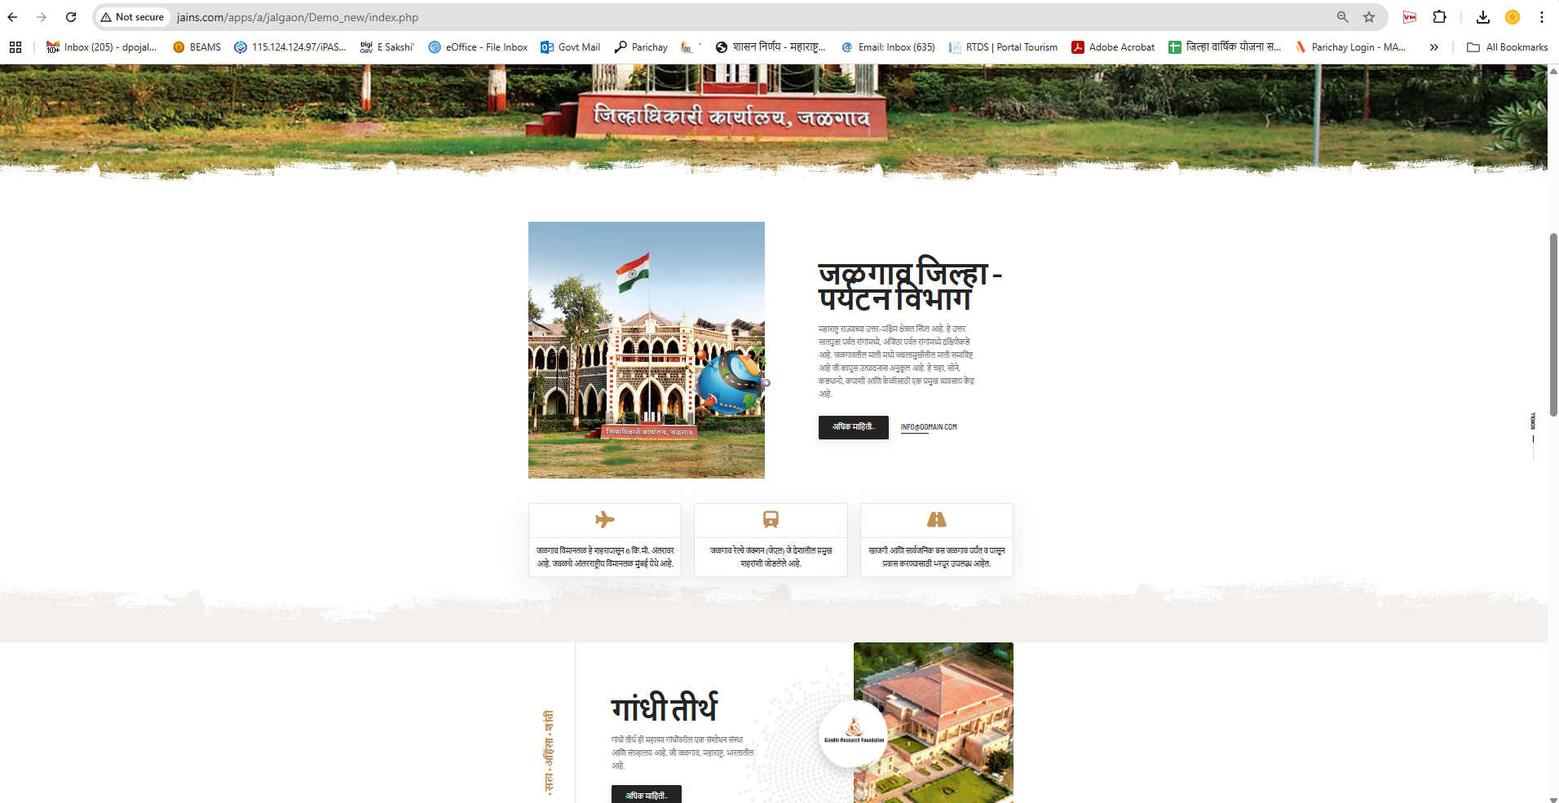
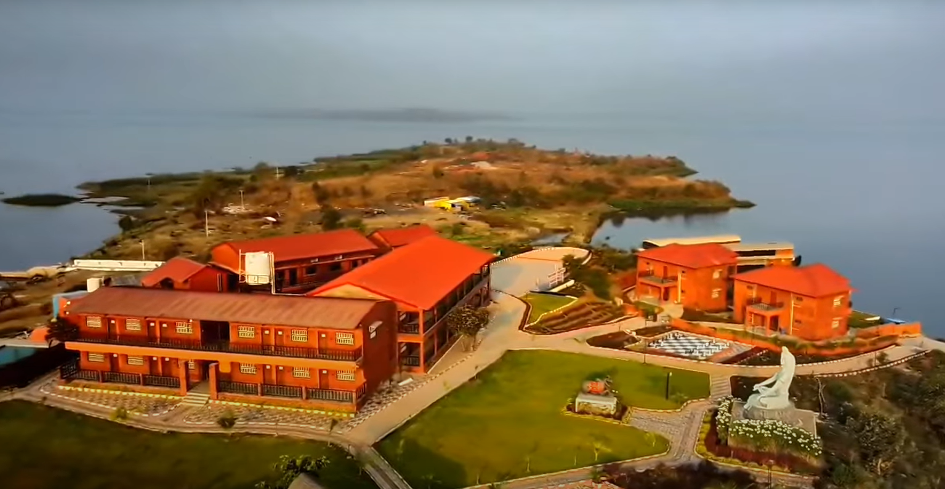
DLI – 3 : Tourism development in districts
Carrying Capacity: Near About 30,000 tourist carrying capacity per day
Developed Tourist Spots: • Landorkhori Garden – 6,500 visitors/day • Sonbardi Garden, Jamner – 3,500 visitors/day
₹336.57 crore under the Regional Tourism Development Plan
Zero - Bhaskaracharya Innovation Centre sanctioned at Patnadevi
Dark Sky Park: DPR preparation underway for Patnadevi and Yawal Wildlife Sanctuary
Advertisement for 25 Locations
Started Forest Safari
Tourism Website
Garkheda Resort At Waghur

Slide 7
Way forward & innovation approach
Institutional Mechanism
Establishment of District Strategic Unit (DSU) as the key implementation body for the District Strategic Plan (DSP).
Coordinated leadership under District Collector, DPO, and PD DRDA, supported by:
4 Professional Interns
2 Dedicated Operators
Adoption of National Frameworks
Integration of Government of India’s Output & Outcome Monitoring Framework (NITI Aayog) for measurable impact tracking and results-based planning.
DPPMU
Resource Optimization
Efficient management of key resources:
1. Land
2. Labour
3. Excess Water
4. Excess Power & Energy
Public-Private Innovation
Promotion of private sector collaboration for efficient service delivery and sustainable development models.
Emphasis on:
License Facilitation Support
Market Access & Export Linkages
Transport & Logistics Enablement
100% capitalization of viable businesses with a focus on capital maximization and entrepreneurial support.
Technology & Real-Time Monitoring
Use of Gati Shakti Portal for:
Infrastructure gap analysis
Project progress tracking
Data-driven governance
_{Sectoral Focus}
Strategic investment push in high-value sectors, especially Defence Manufacturing
7

Slide 8
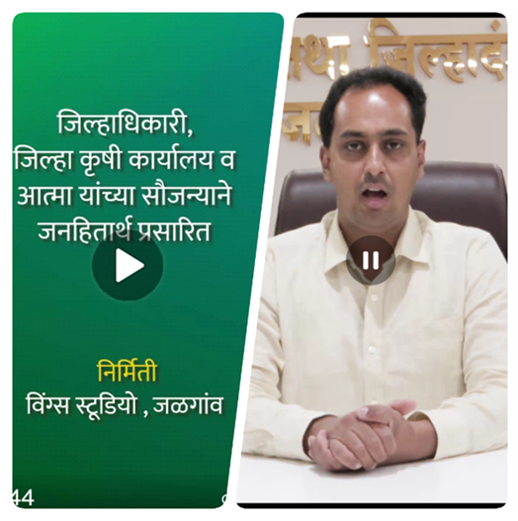
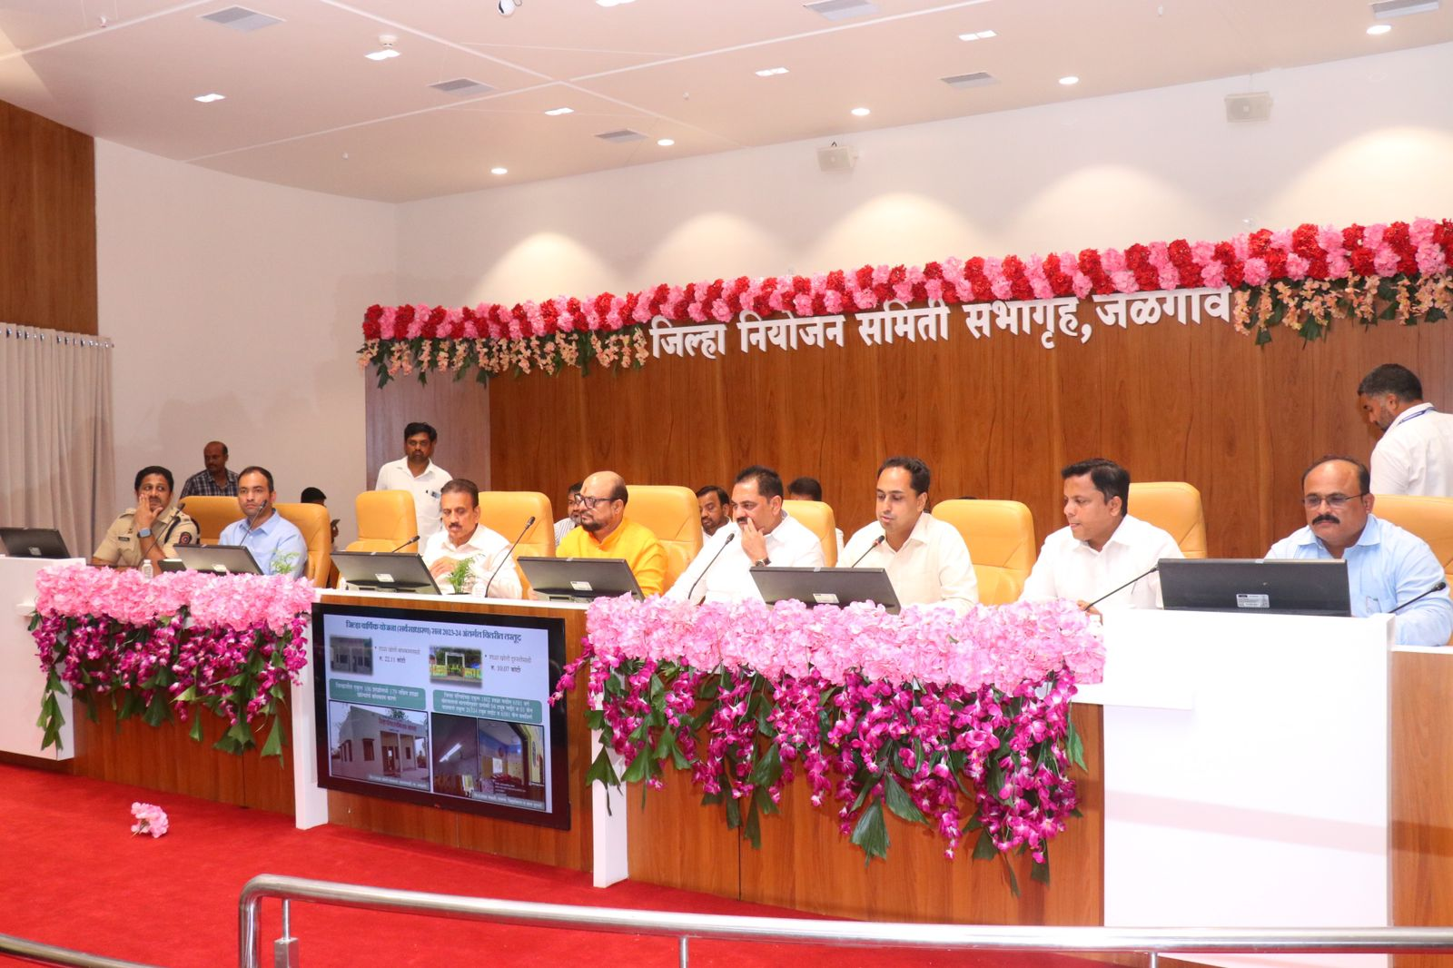


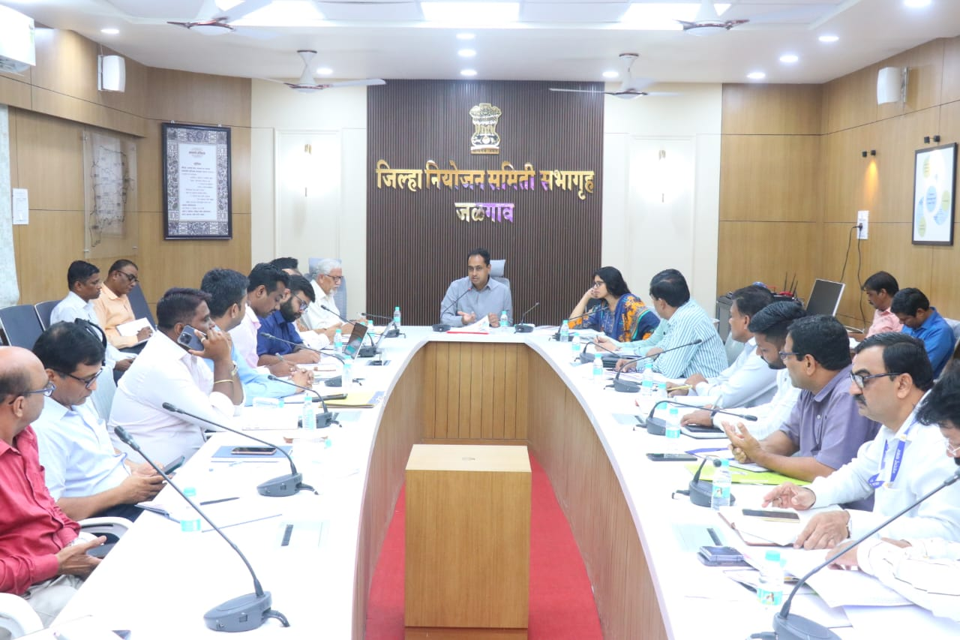


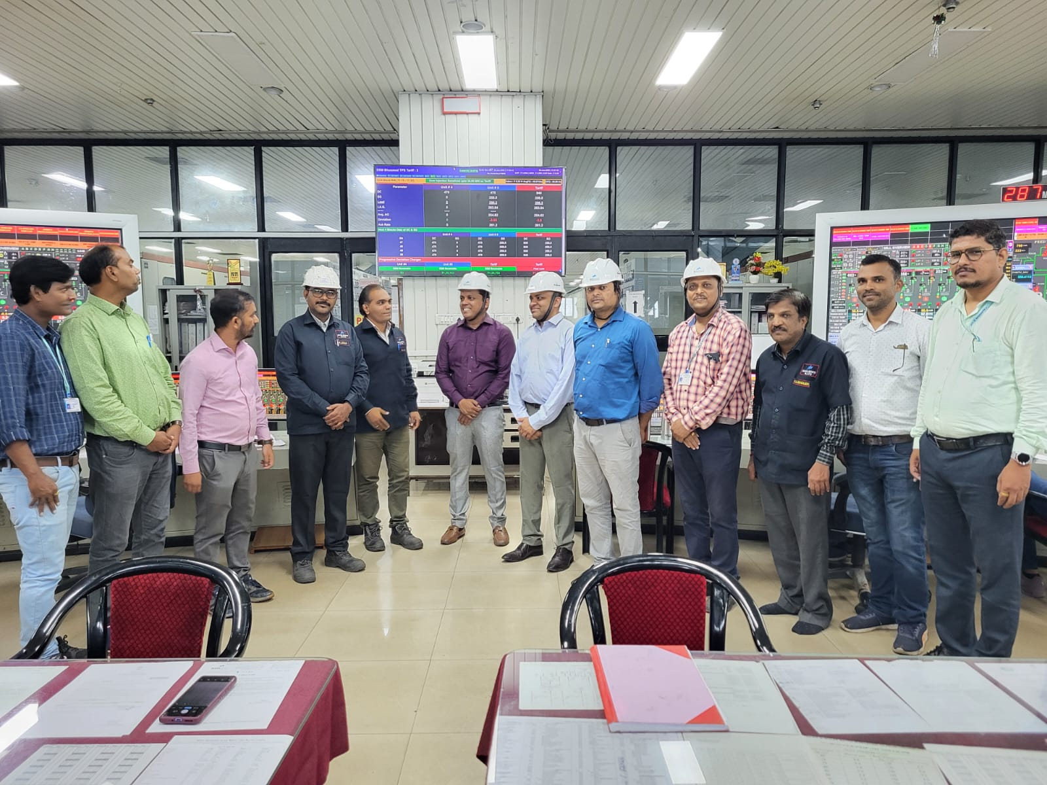



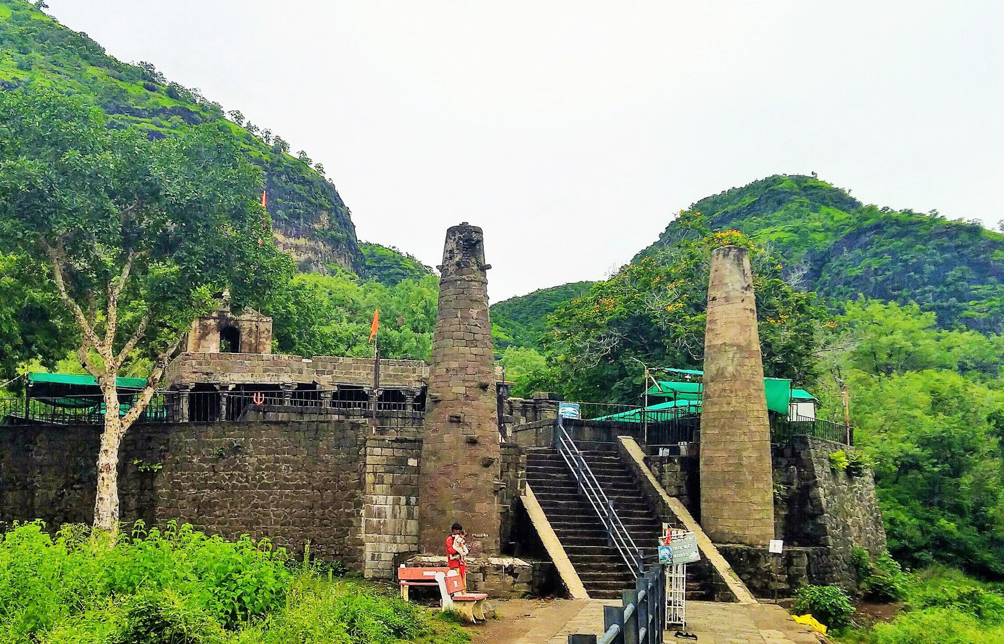
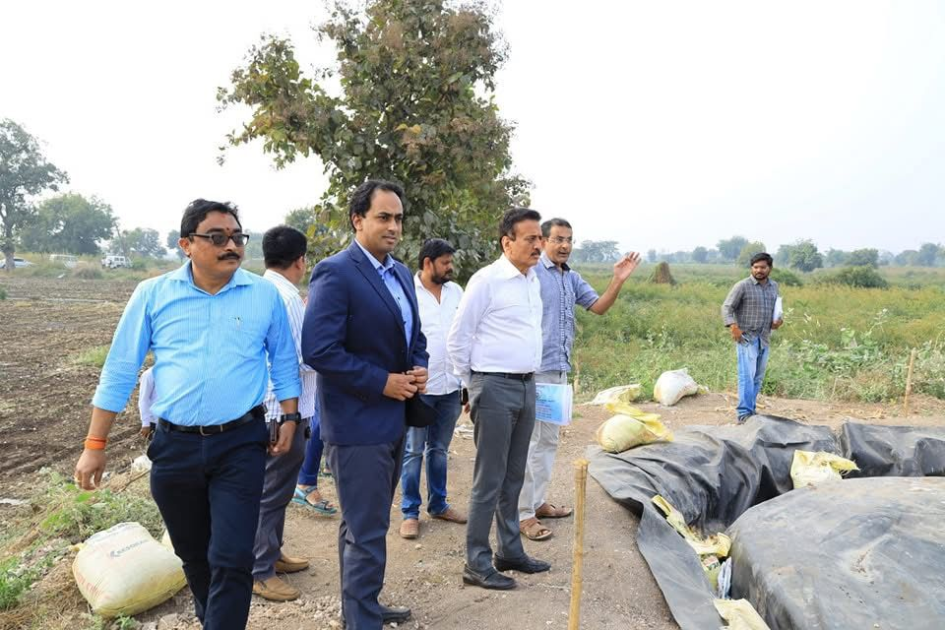


Jalgaon
Precision Manufacturing
Sunrise Sectors
Pet Food
Gold & Jewellery
Fulfillment Centre for E-Commerce
Green Energy
Circular Economy
Thanks
8

